Slide 1


CONOCO: “COping with NO mobility during COrona Virus times: Learning from each other”
Project Number: 2020-1-CY01-KA204-066035
Website: www.co-no-co.eu
Title of Presentation: Assessment of the Kick-off meeting held on October 5th ,2020
This project has been funded with support from the European Commission.
This PowerPoint reflects the views only of the author, and the Commission cannot be held responsible for any use which may be made of the information contained herein.

Slide 2

The Questionnaire was sent to all partners with the following format:
2

Slide 3
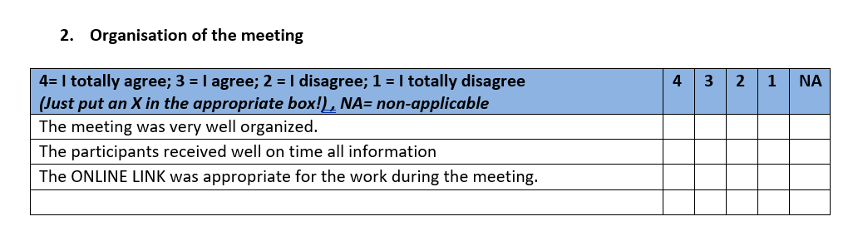

Slide 4
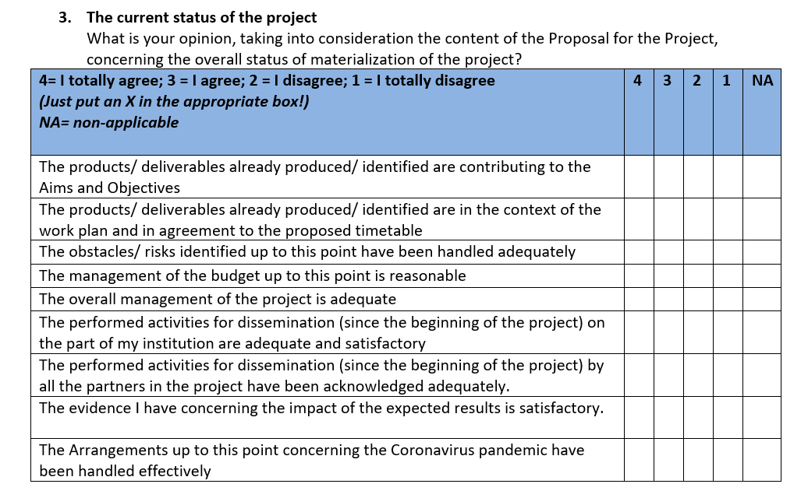

Slide 5
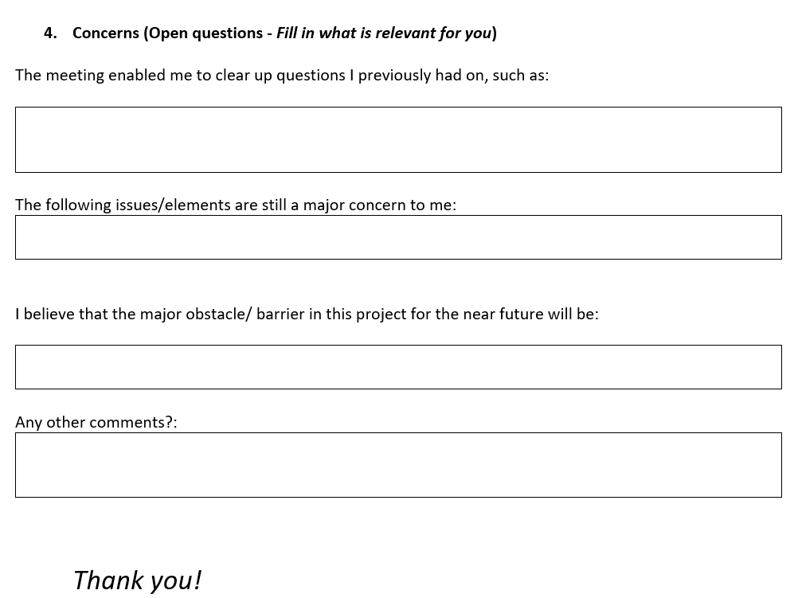

Slide 6
The questionnaire was answered trough Google form by 9 individuals who took part in the meeting.
These answers are as following:

Slide 7
1. Content and work in the meeting:

Slide 8
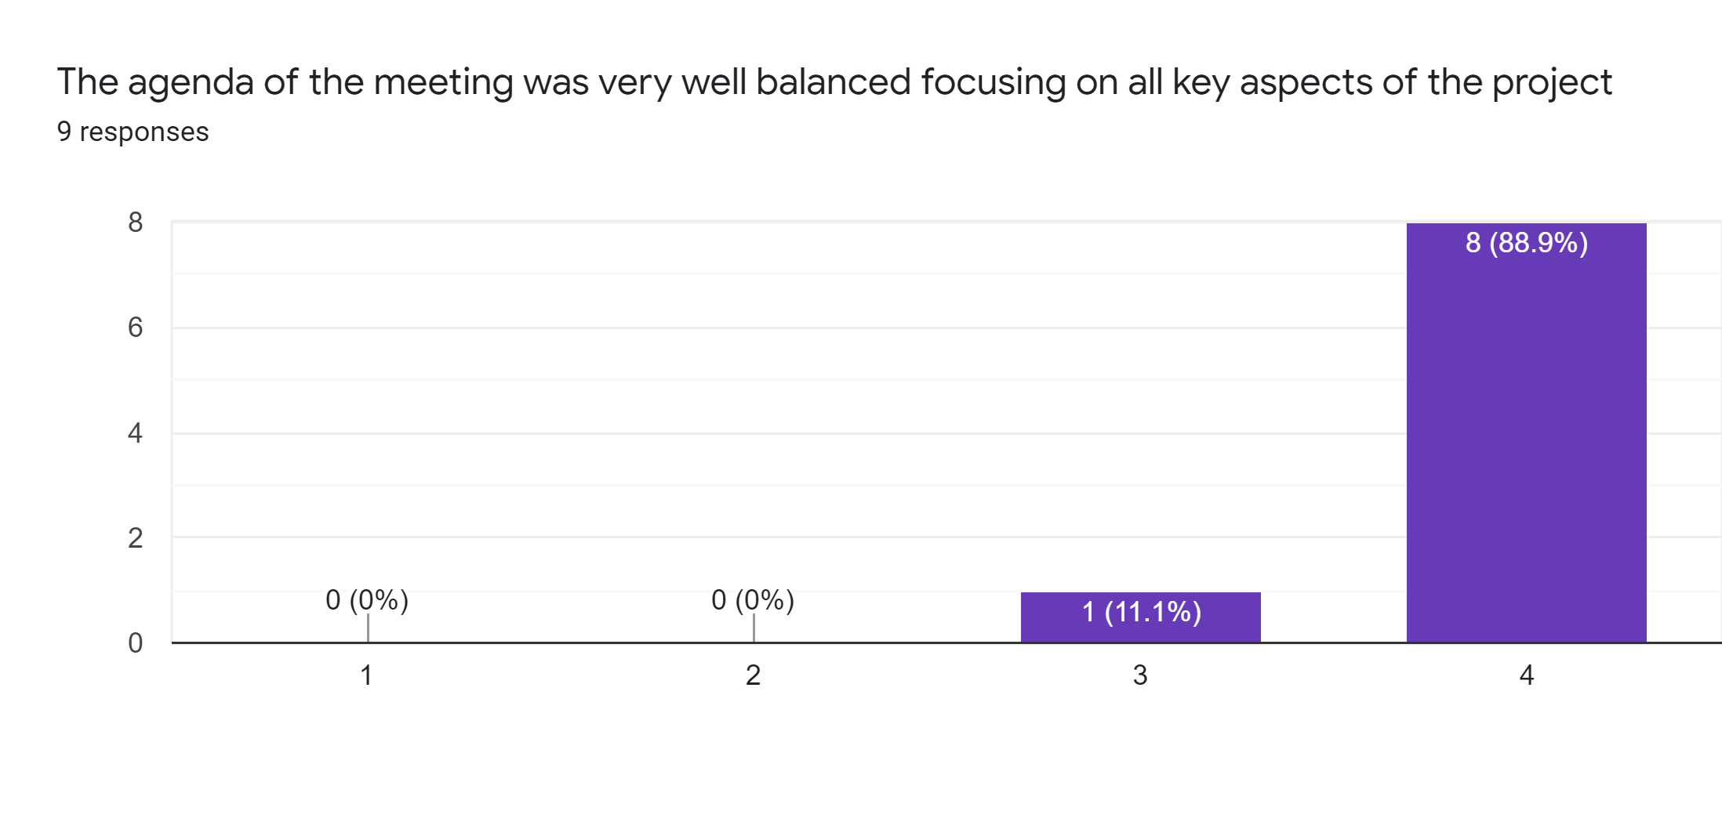

Slide 9


Slide 10
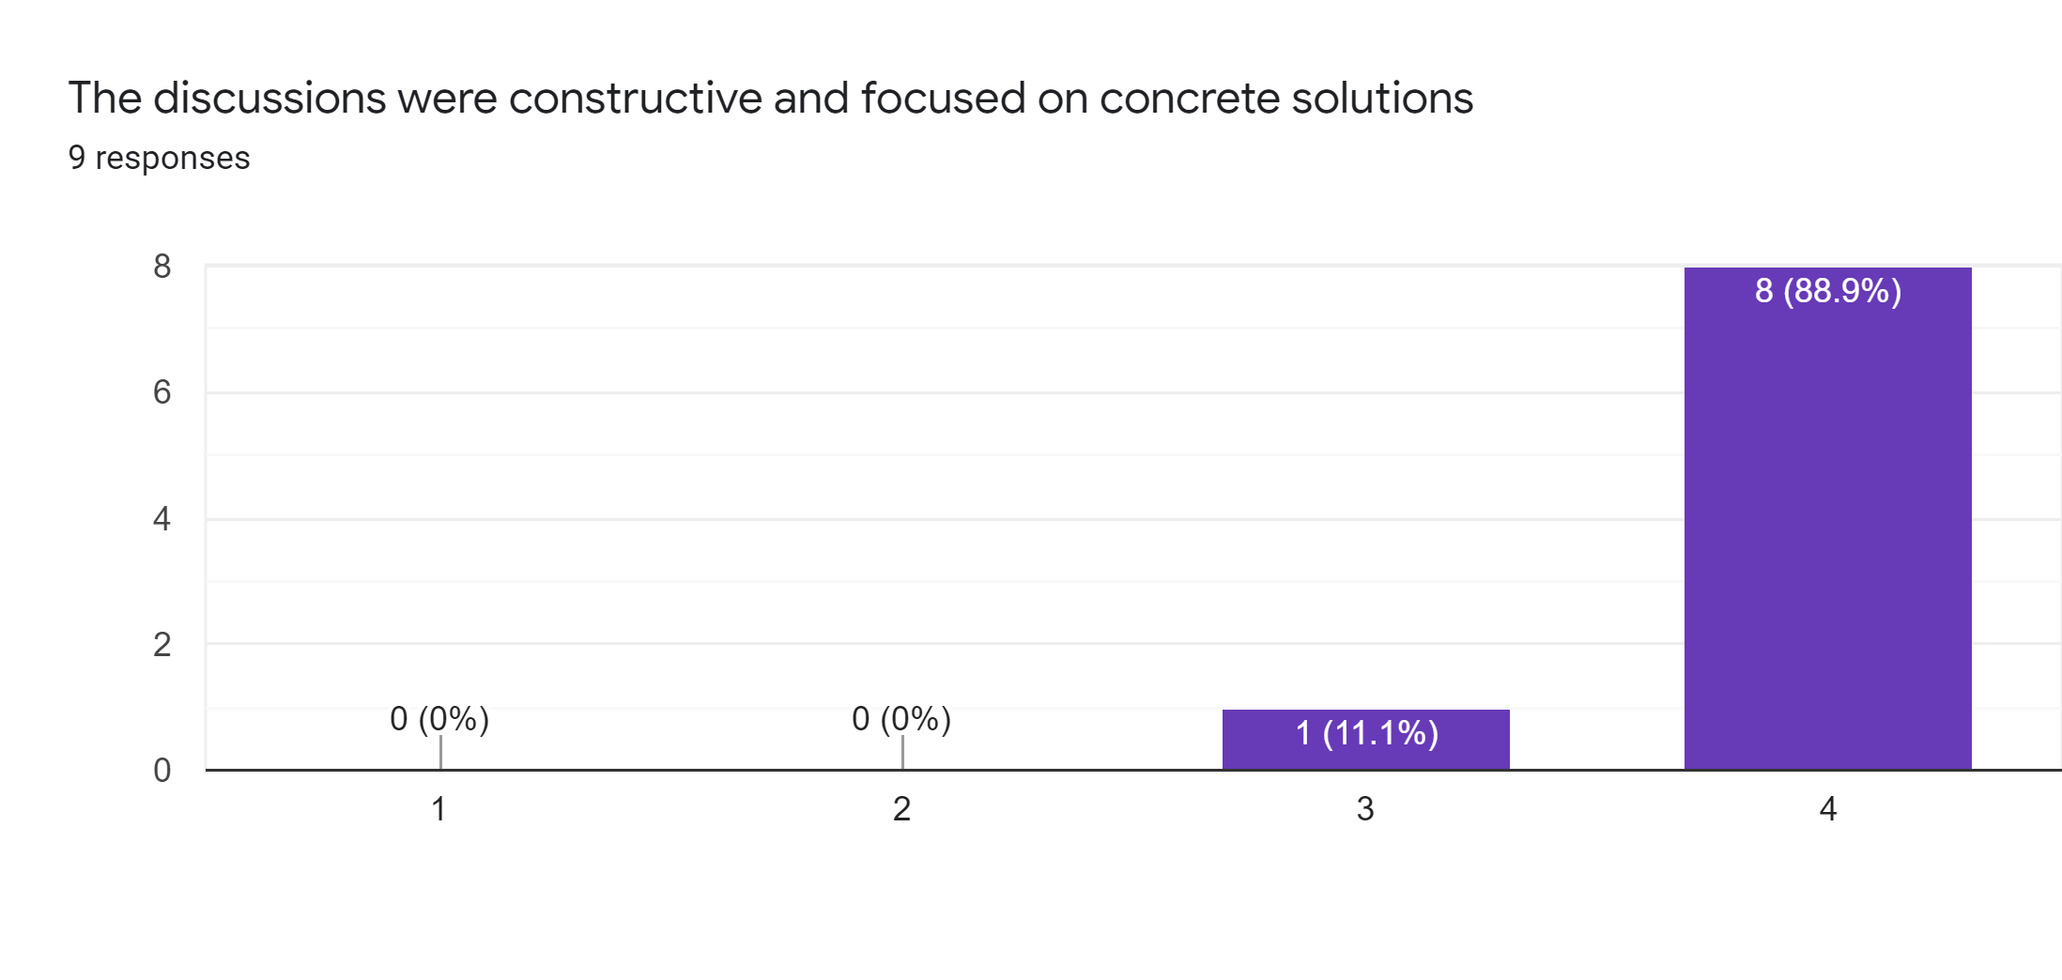

Slide 11


Slide 12
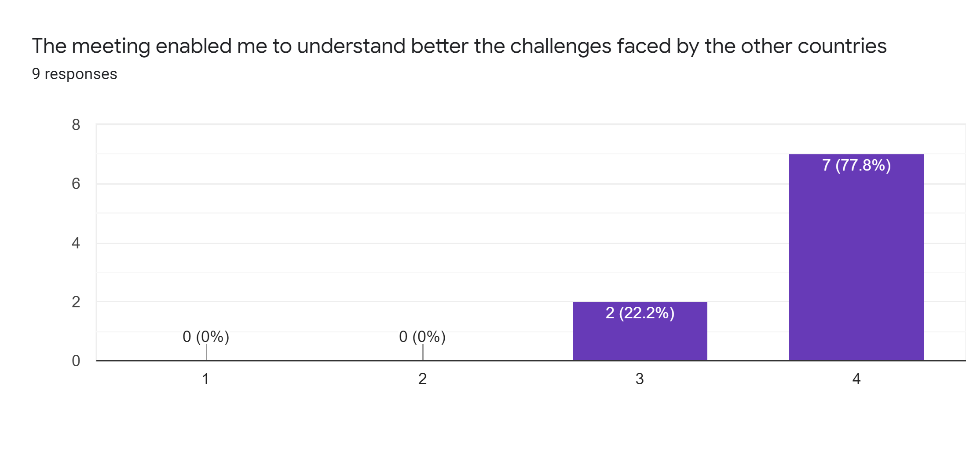

Slide 13
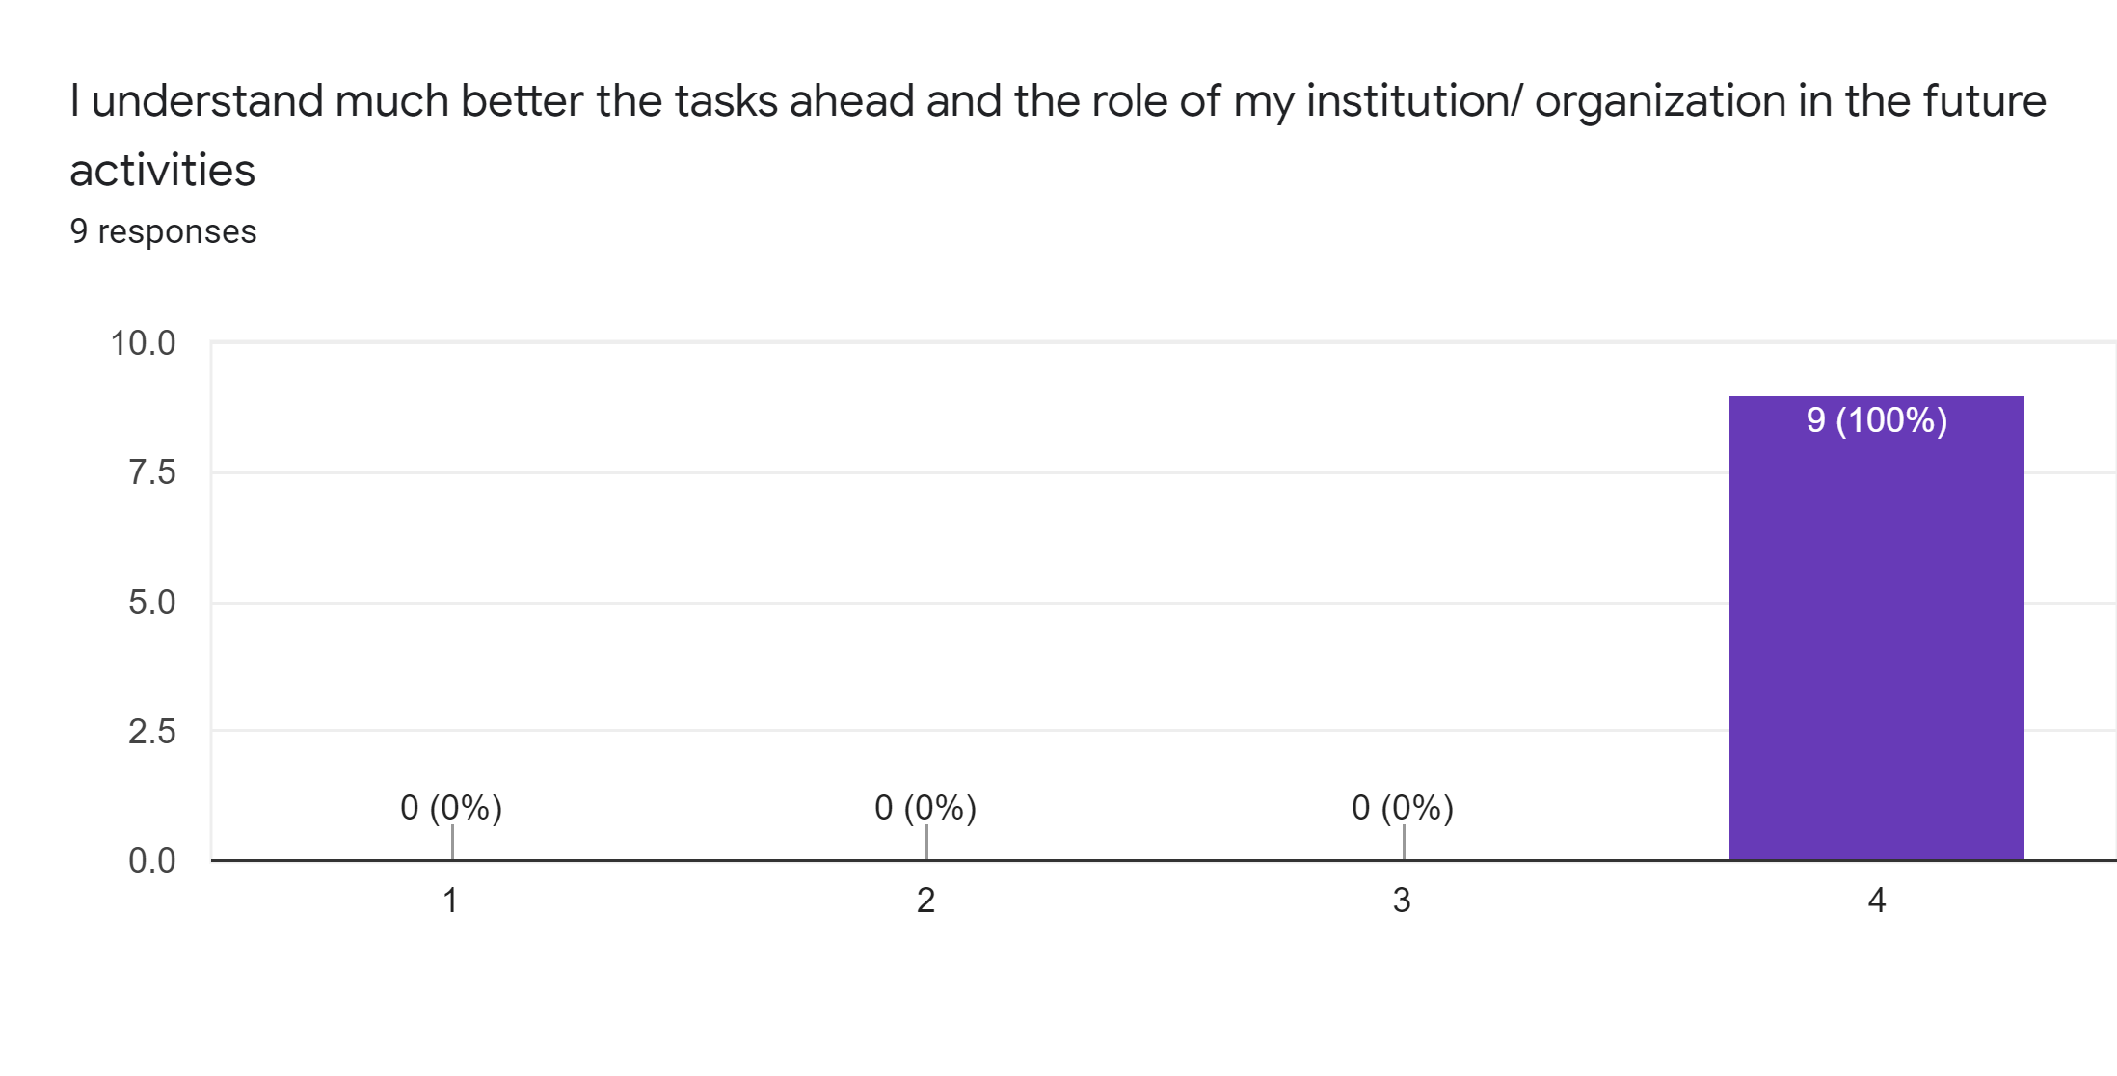

Slide 14


Slide 15
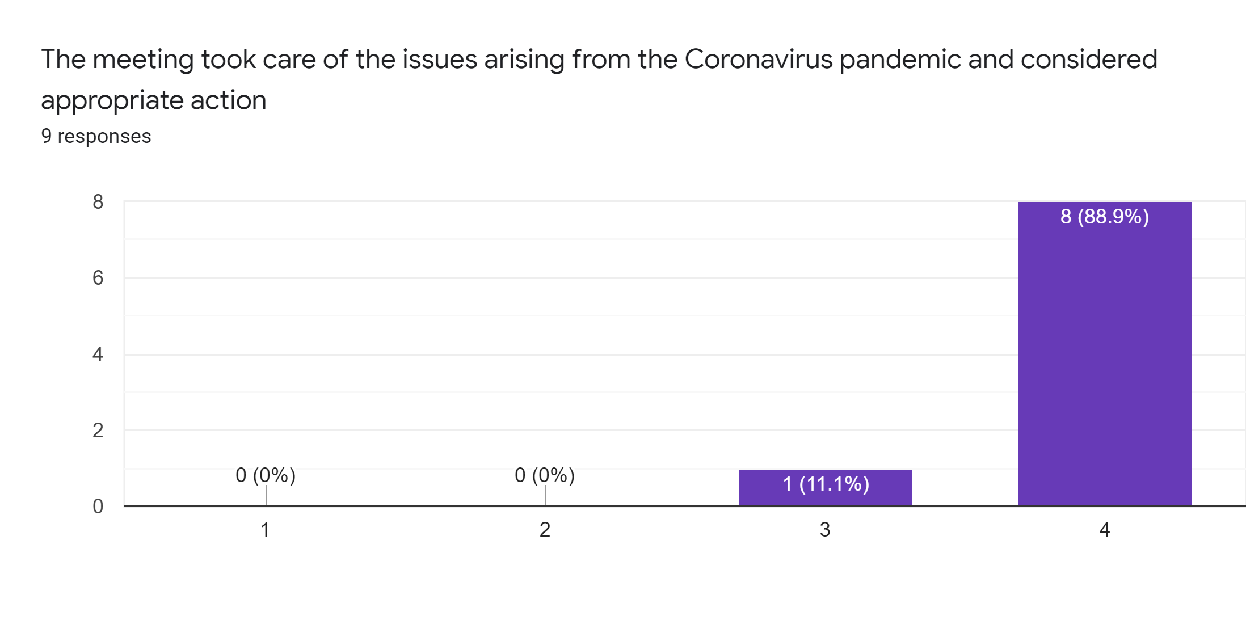

Slide 16
The information given helped me better understand…

Slide 17


Slide 18


Slide 19


Slide 20


Slide 21
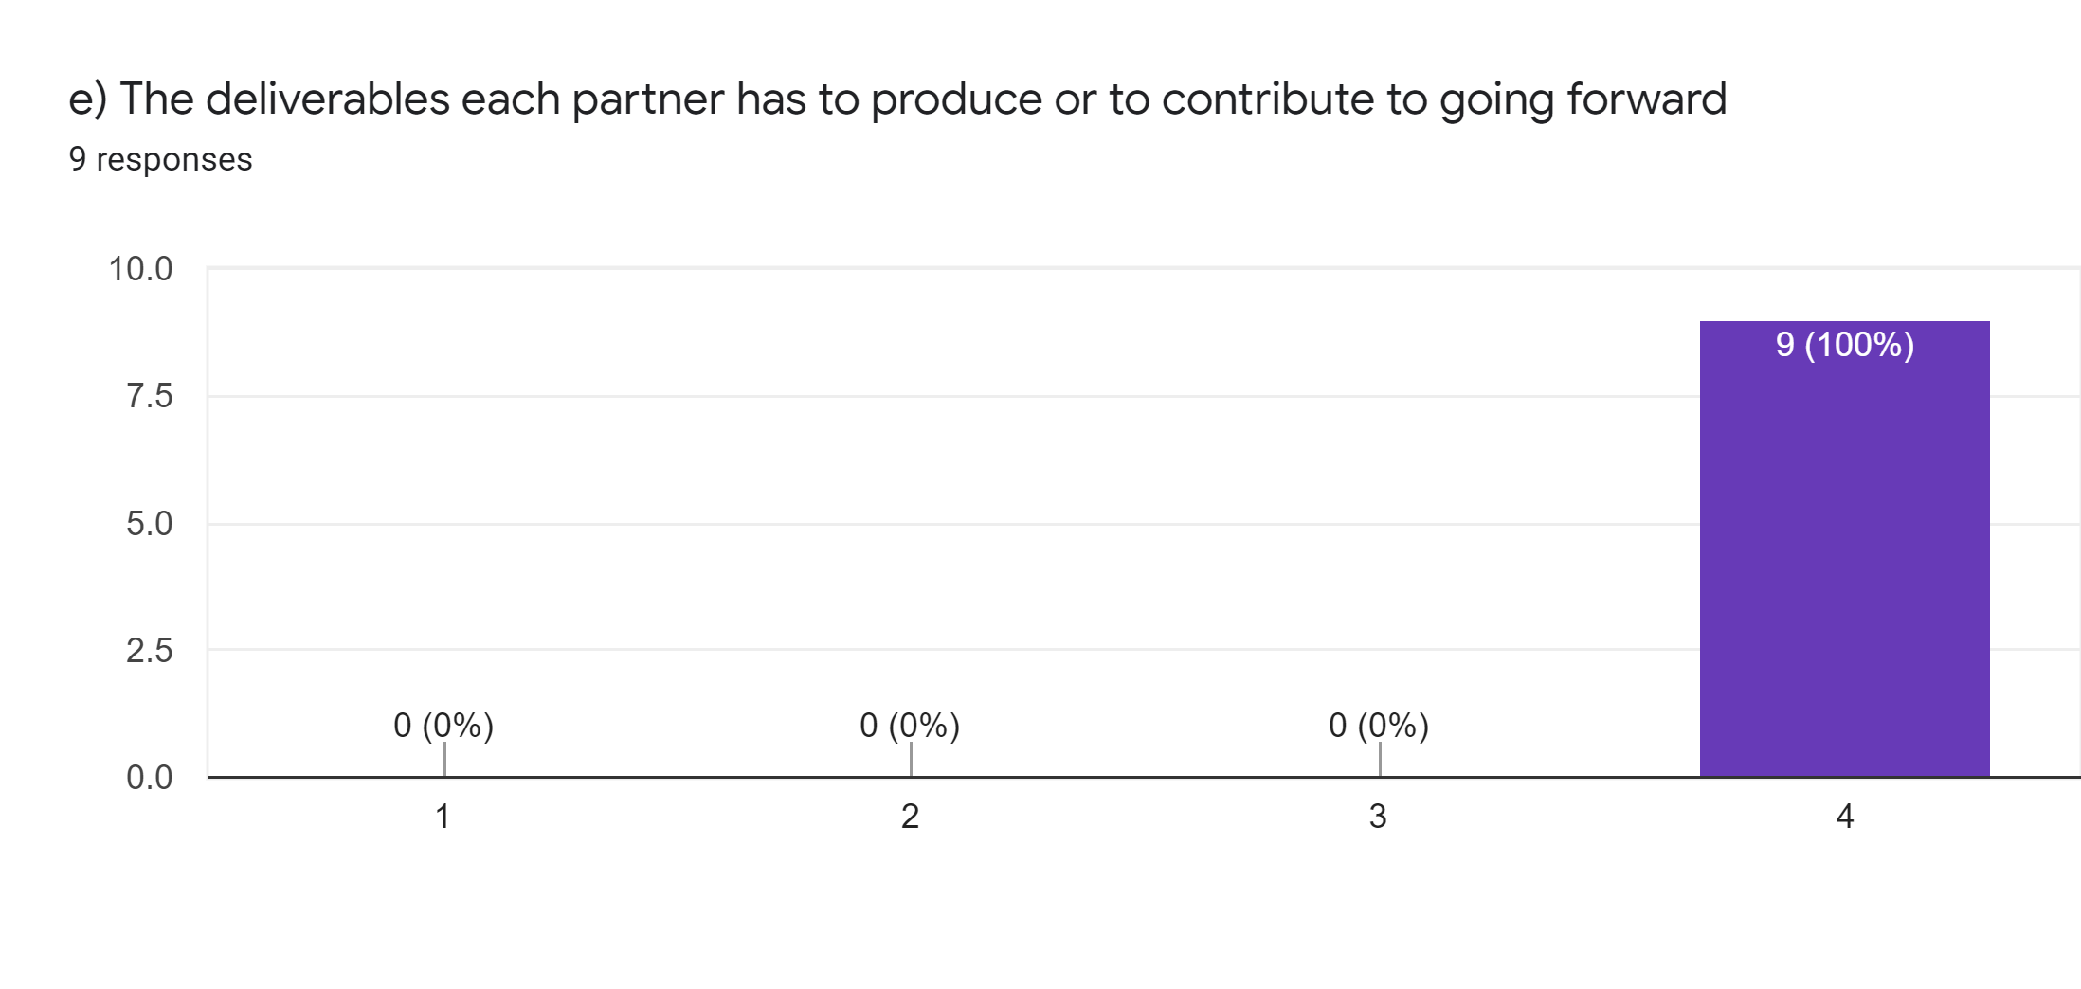

Slide 22
2. Organisation of the Meeting

Slide 23


Slide 24


Slide 25


Slide 26
3. The current status of the project

Slide 27
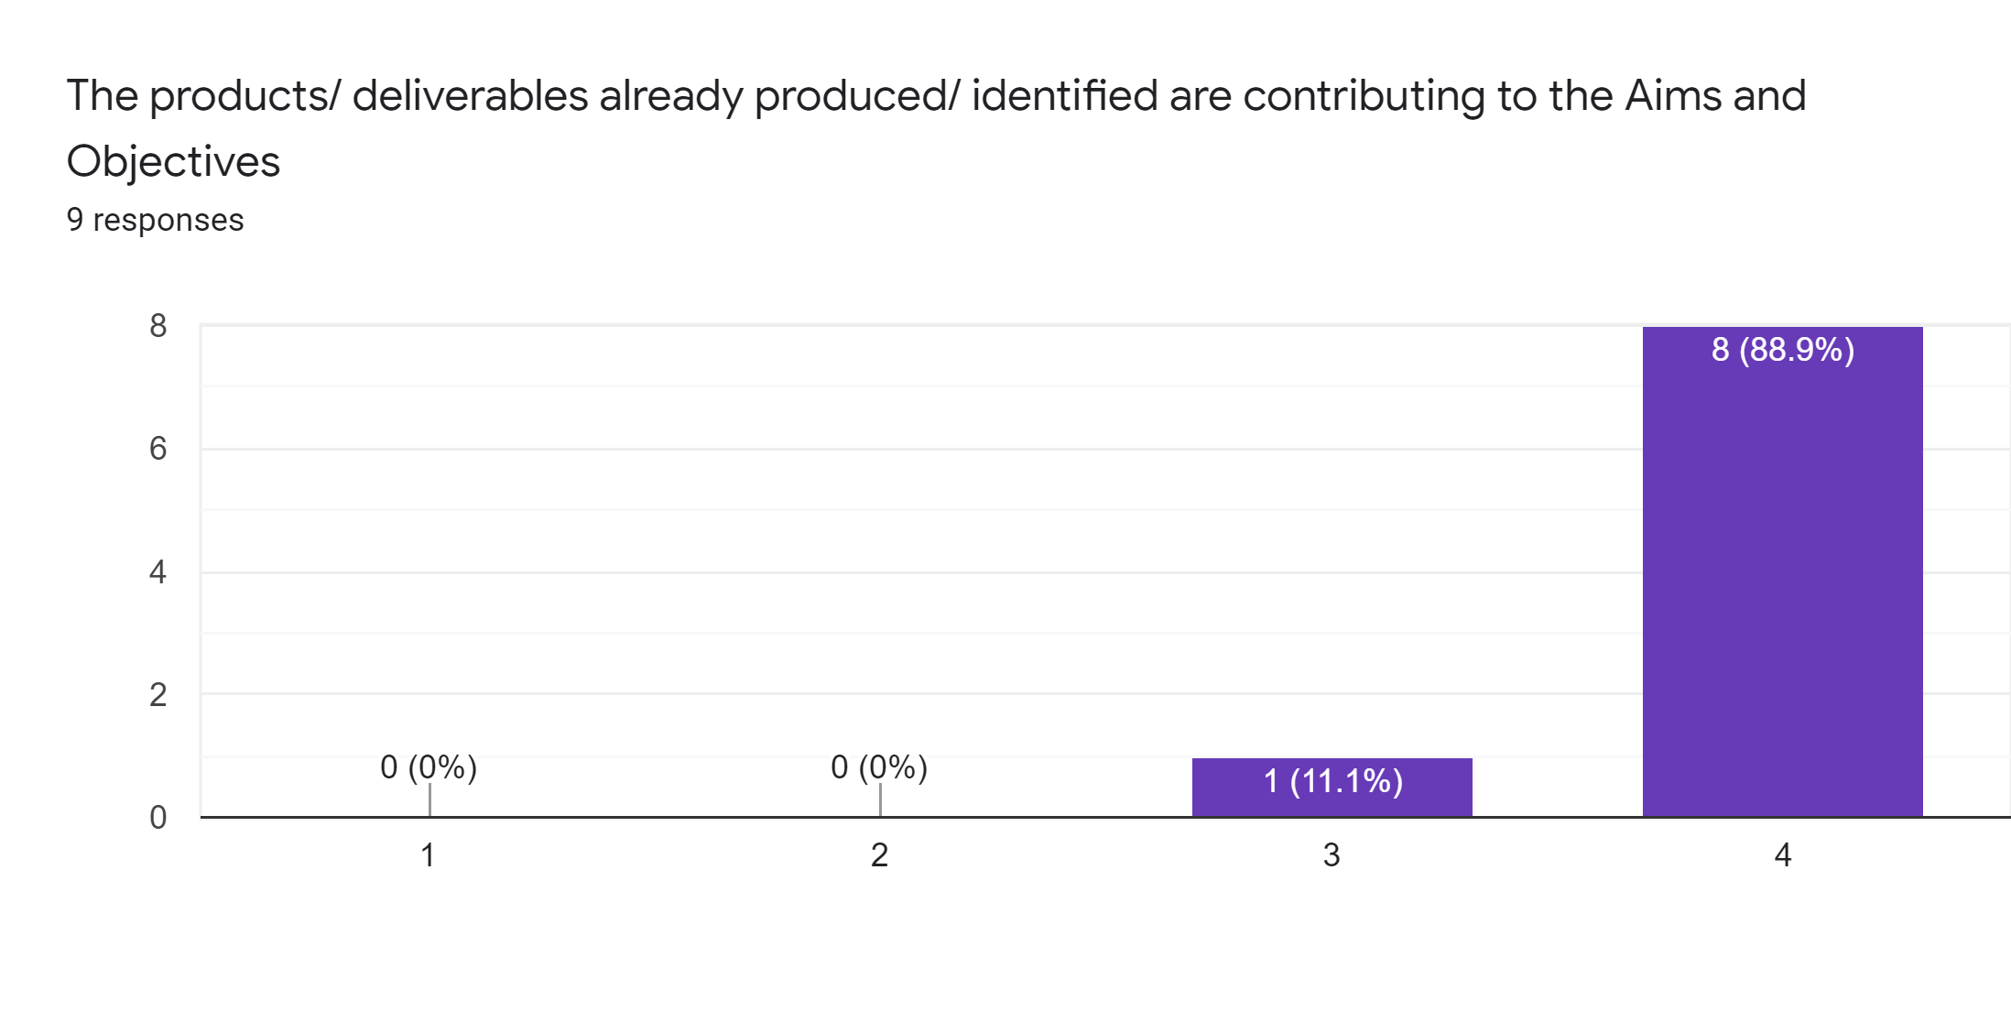

Slide 28
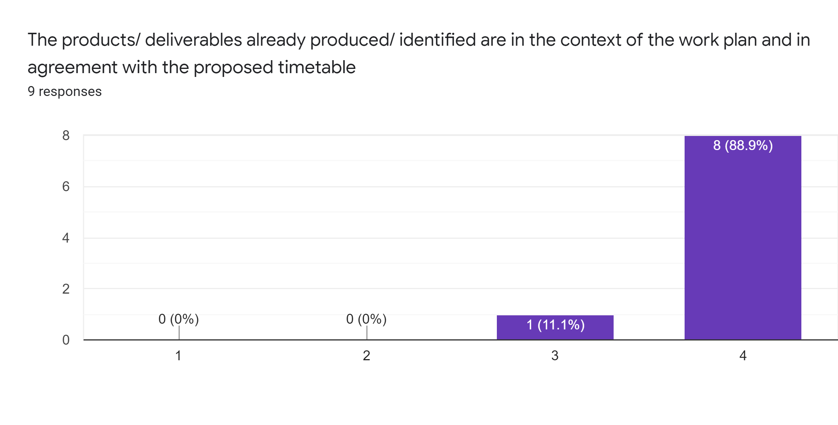

Slide 29
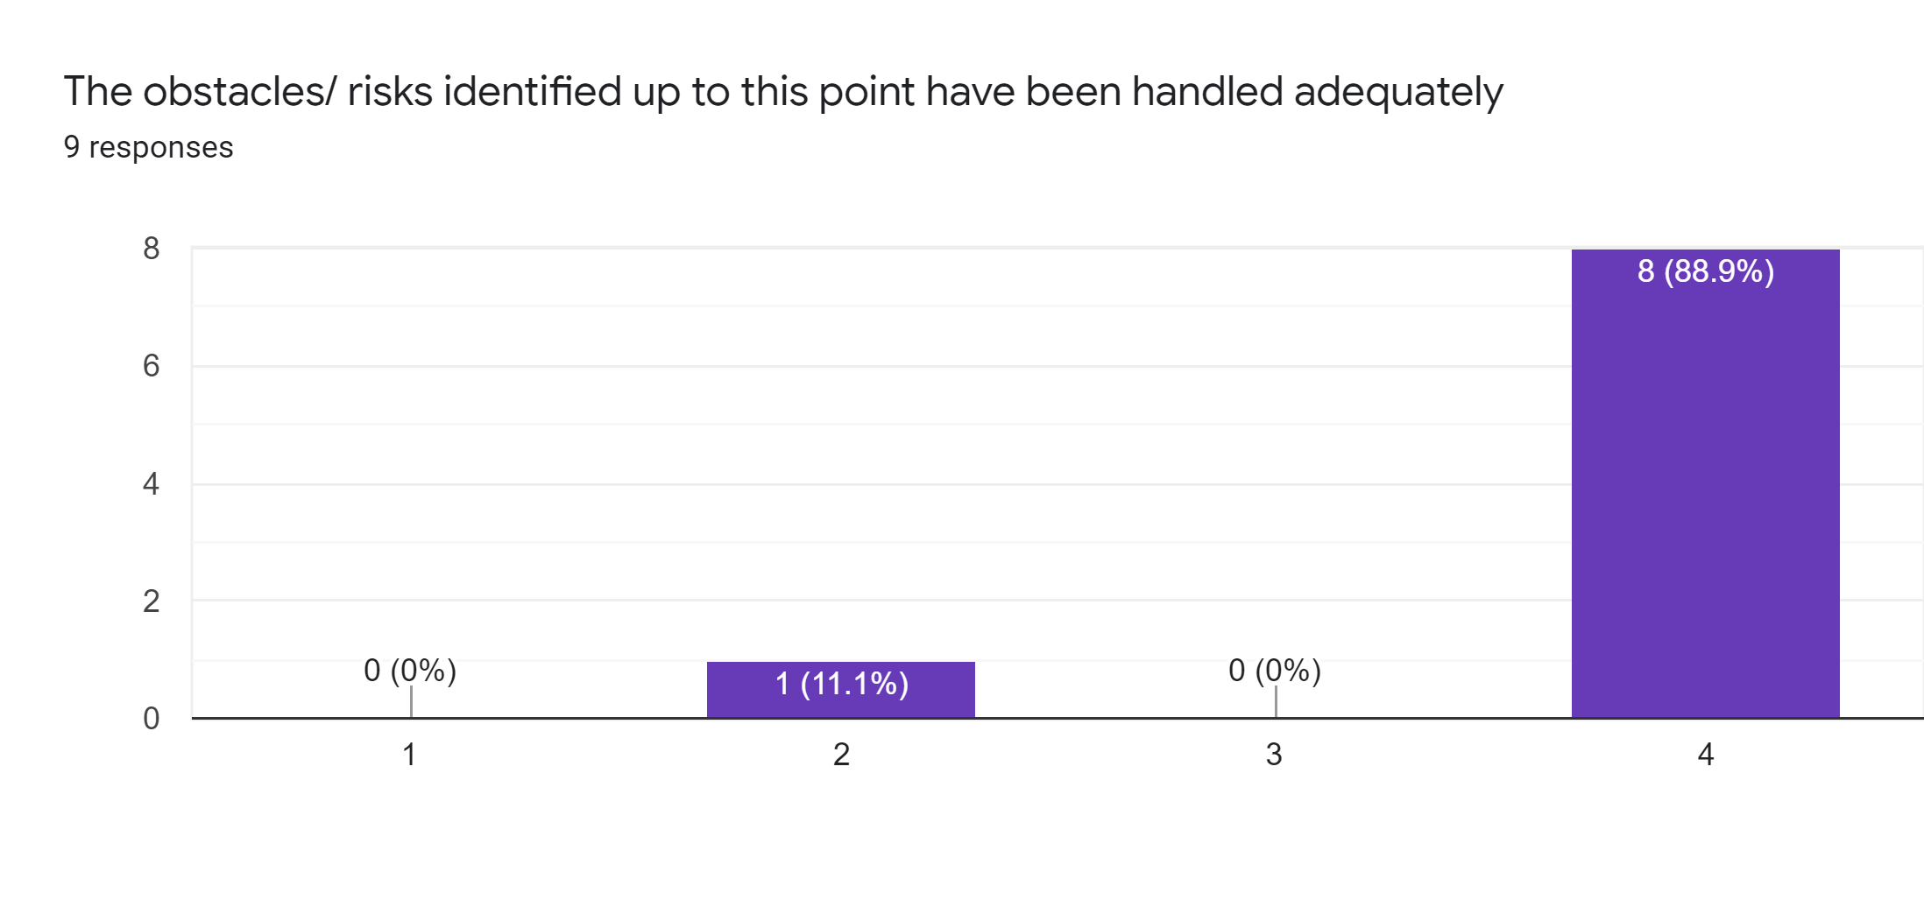

Slide 30


Slide 31


Slide 32
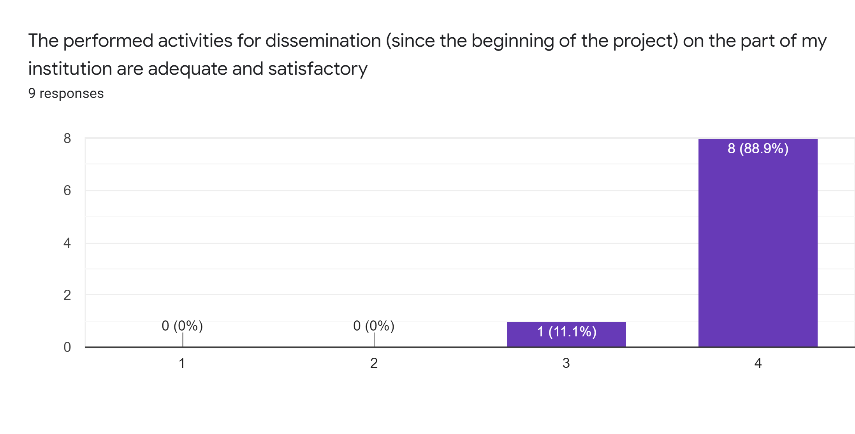

Slide 33
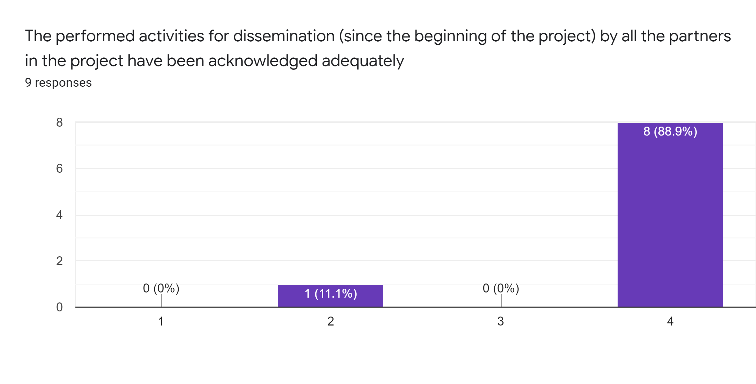

Slide 34


Slide 35
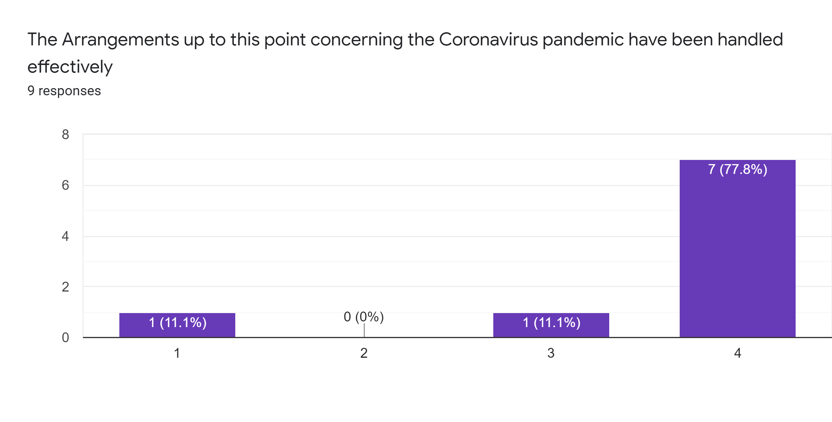

Slide 36
4. Concerns (Open questions - Fill in what is relevant for you)

Slide 37
The meeting enabled me to clear up questions I previously had on, such as:
The way in which the online survey is going to be implemented
To understand better the deliverables for each partner.
The tasks in charge of my institution
What are the next activities in the project.

Slide 38
The following issues/elements are still a major concern to me:
People's availability and willingness for participating in video testimonials
The dissemination is still a great concern as I know that the success of a European project is strictly linked to a dissemination plan. So, we need to work hard in it.
I don't think there are any problems we can't solve.

Slide 39
I believe that the major obstacle/ barrier in this project for the near future will be:
I think that a big challenge will be to find enough people for the questionnaires.
I fear that the emergency situation will prevent the projects' partners from meeting, organizing events together and reinforcing the network they have been building thanks to this project.
The scheduling of TPM
The pandemic situation is a very big obstacle because the activities planned have to be done online and we need to meet each other and to work in blended procedure, not only online. Another problem is connected with the situation in each country related to the pandemic. In my town is very difficult to involve people because some of them have lost confidence and trust. We are working to connect people online, even if it is difficult because the target ( elder people) sometimes doesn’t have experience and competence using ICT.
A possible delay in performing the tasks, due to objective reasons
I don't think there will be major problems that we can't solve.

Slide 40
Any other comments? :
The project is important!
NONE

Slide 41
CONCLUSIONS
In general, the meeting was successful, but some action is needed for the concerns expressed and to mitigate any major obstacle/ barrier in this project for the near future.

Slide 42






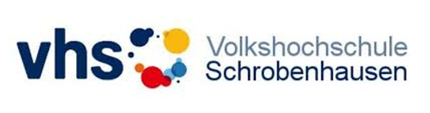

CONOCO Partners
Project Number: 2020-1-CY01-KA204-066035

